Slide 1

Topic: Control Volume analysis of 1st Law
Lecture – 6
Disclaimer:
The study materials/presentations are solely meant for academic purposes and they can be reused, reproduced, modified, and distributed by others for academic purposes only with proper acknowledgements.

Slide 2
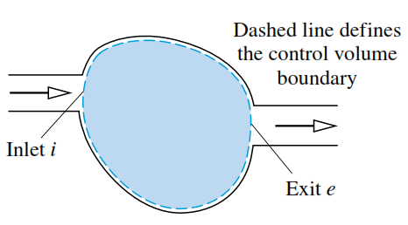
  Devices such as turbines, pumps, and compressors through which mass flows are thought of a region in space through which mass flows (a control volume).
  Like closed system, energy transfer across the boundary of a control volume can occur by means of heat and work.
  In addition, another type of energy transfer must be accounted for, the energy accompanying mass as it enters or exits.
  Conservation of mass for a control volume:
  A control volume with mass flowing in at $i$ and flowing out at $e$, respectively.
  Application of conservation of mass states that:

Slide 3
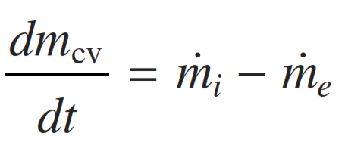
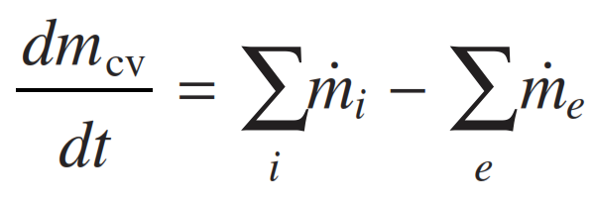
  $\left[\begin{aligned}\text{time} \text{rate} \text{of} \text{change} \text{of} \\ \text{mass} \text{contained} \text{within} \text{the} \\ \text{control} \text{volume} \text{at} \text{time} \text{t}\end{aligned}\right]=\left[\begin{aligned}\text{time} \text{rate} \text{of} \text{flow} \text{of} \\ \text{mass} \text{in} \text{across} \\ \text{inlet} \text{i} \text{at} \text{time} \text{t}\end{aligned}\right]−\left[\begin{aligned}\text{time} \text{rate} \text{of} \text{flow} \\ \text{of} \text{mass} \text{out} \text{across} \\ \text{exit} \text{e} \text{at} \text{time} \text{t}\end{aligned}\right]$
  This statement can be expressed in symbols as
  In SI, all terms in above equation are expressed in kg/s.
  There may be several locations on the boundary through which mass enters or exits.
  Now, mass flow rate $\dot{m}$ can be obtained in terms of local properties.

Slide 4
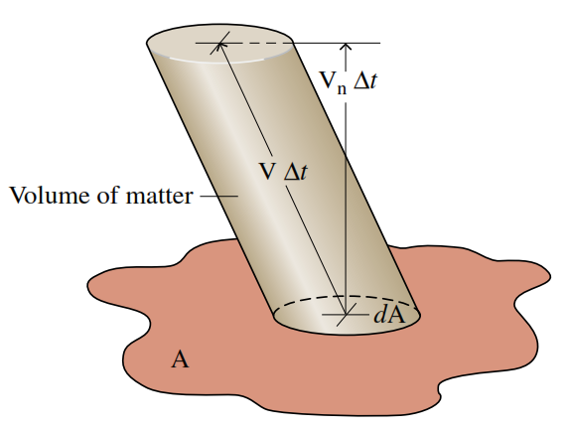
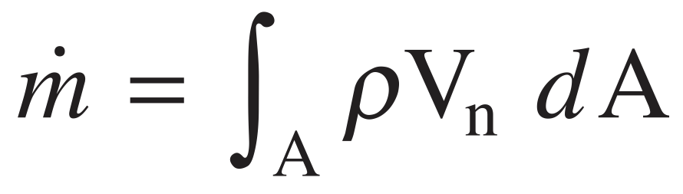
  Let us considering a small quantity of matter flowing with velocity $V$ across an incremental area $dA$ in a time interval $Δt$, as shown in figure.
  $V_{n}$ denotes the component of the relative velocity normal to $dA$ in the direction of flow.
  The volume of the matter (contained in the oblique cylinder) is the product of the area of its base $dA$ and its altitude $V_{n}Δt$.
  Amount of mass that crosses $dA$ in time interval $Δt$ is ${ρ(V}_{n}Δt)dA$
  The instantaneous mass flow rate is then ${ρV}_{n}dA$
  When this is integrated over the area A, mass flow rate is obtained as

Slide 5
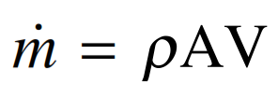
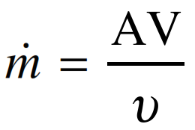
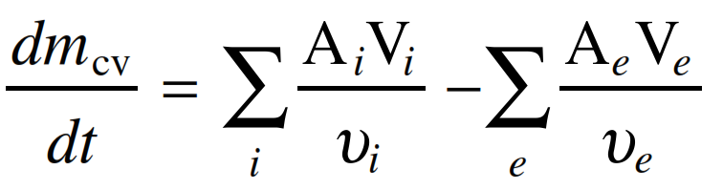
  One-Dimensional Flow Form of the Mass rate Balance:
  The flow is normal to the boundary at locations where mass enters or exits the CV.
  All intensive properties, including velocity and density, are uniform with position over each inlet or exit area through which matter flows.
  Once these two idealizations are satisfied, the flow is said to be one-dimensional.
  Mass flow rate becomes or
  The product AV is the volumetric flow rate (m³/s).
  Substituting this expression of mass flow rate in conservation of mass principle for control volumes gives

Slide 6
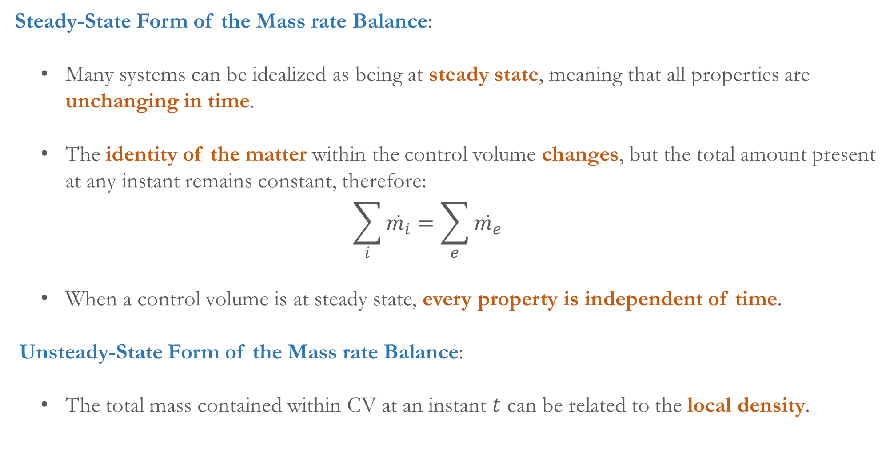
  Steady-State Form of the Mass rate Balance:
  Many systems can be idealized as being at steady state, meaning that all properties are unchanging in time.
  The identity of the matter within the control volume changes, but the total amount present at any instant remains constant, therefore:
  $$\sum_{i}{\dot{m_{i}}}=\sum_{e}{\dot{m_{e}}}$$
  When a control volume is at steady state, every property is independent of time.
  Unsteady-State Form of the Mass rate Balance:
  The total mass contained within CV at an instant $t$ can be related to the local density.

Slide 7
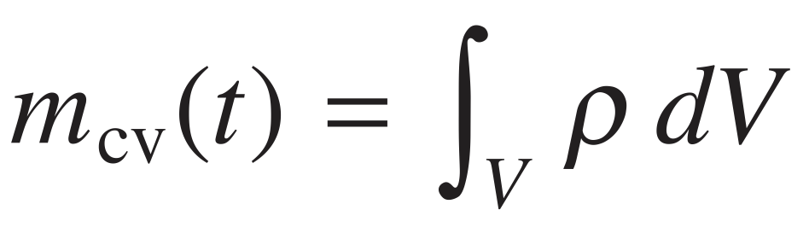
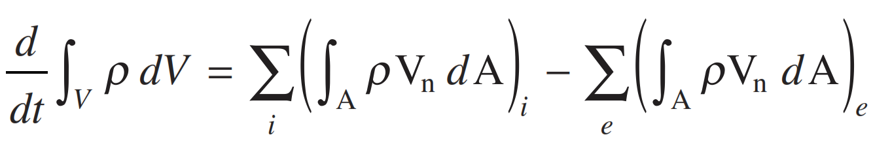
  Now, the mass rate balance can be written as
  The product $ρV_{n}$ appearing in this equation, known as the mass flux, gives the time rate of mass flow per unit of area.
  Conservation of Energy for a Control Volume:
  Like mass, energy is an extensive property, so it too can be transferred into or out of a control volume as a result of mass crossing the boundary.

Slide 8
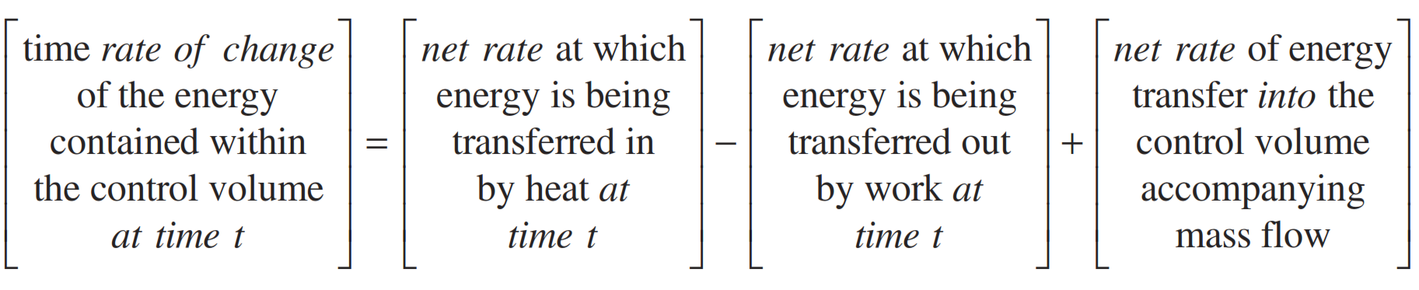
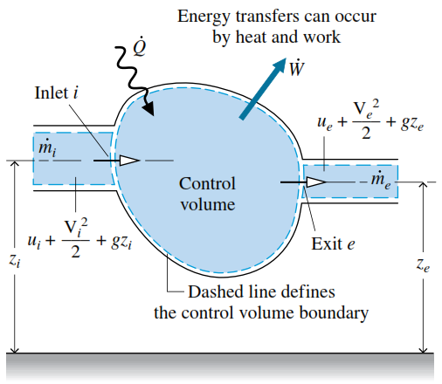
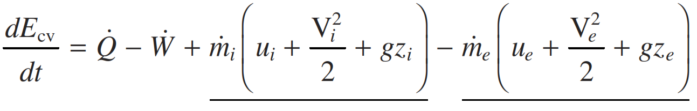
  This is the principal difference between the closed system and control volume forms.
  Accordingly, the conservation of energy principle applied to a control volume states
  For the one-inlet, one-exit control volume with one-dimensional flow the energy rate balance is
  The underlined terms account for the rates of transfer of internal, kinetic, and potential energy of the entering and exiting streams.

Slide 9
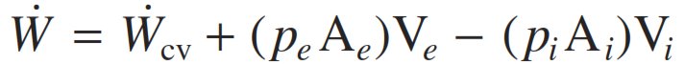
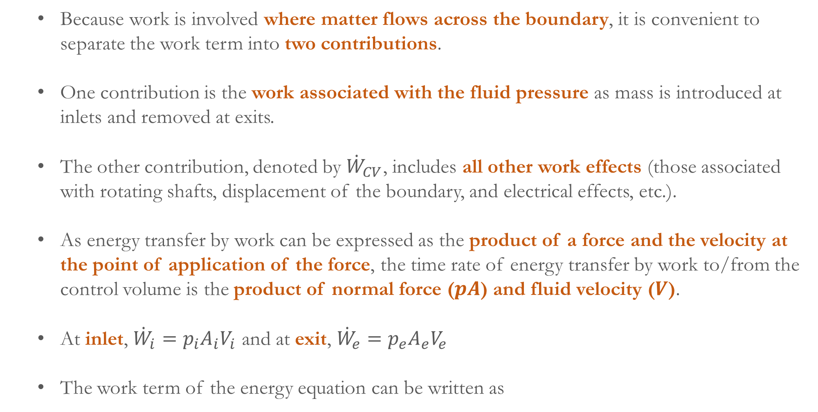
  Because work is involved where matter flows across the boundary, it is convenient to separate the work term into two contributions.
  One contribution is the work associated with the fluid pressure as mass is introduced at inlets and removed at exits.
  The other contribution, denoted by ${\dot{W}}_{CV}$, includes all other work effects (those associated with rotating shafts, displacement of the boundary, and electrical effects, etc.).
  As energy transfer by work can be expressed as the product of a force and the velocity at the point of application of the force, the time rate of energy transfer by work to/from the control volume is the product of normal force ($pA$) and fluid velocity ($V$).
  At inlet, ${\dot{W}}_{i}=p_{i}A_{i}V_{i}$ and at exit, ${\dot{W}}_{e}=p_{e}A_{e}V_{e}$
  The work term of the energy equation can be written as

Slide 10
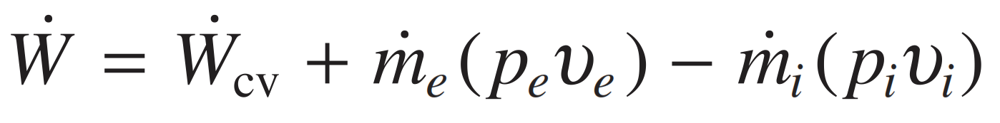
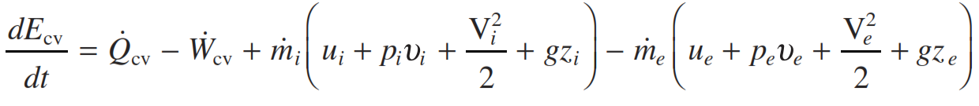
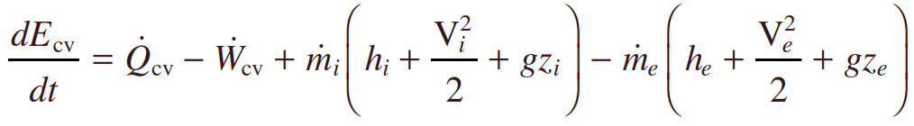
  With $AV=\dot{m}v$, the above expression for work can be written as
  The work associated with the pressure at the inlet and exit is commonly referred to as flow work.
  One-Dimensional Flow Form of the Control Volume Energy rate Balance:
  Collecting all terms referring to the inlet and the exit into separate expressions, we have
  With $h = u + pυ$, the energy rate balance becomes

Slide 11
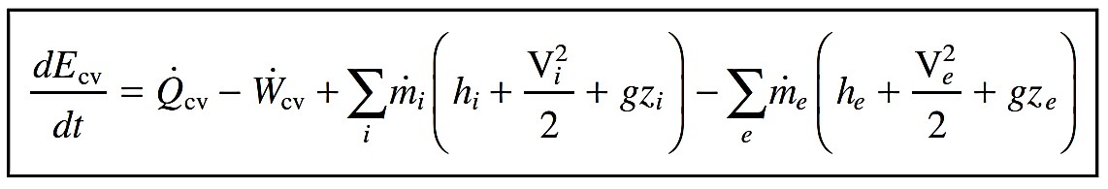
  The appearance of the sum $u + pυ$ in the control volume energy equation is the principal reason for introducing enthalpy previously.
  Considering several locations on the boundary through which mass enters or exits, the energy rate balance is
  Integral Form of the Control Volume Energy rate Balance:
  Similar to mass rate balance, the energy rate balance can be expressed in terms of local properties to obtain forms that are more generally applicable.
  The total energy associated with the control volume at time $t$ ($E_{CV}$), can be written as a volume integral.

Slide 12
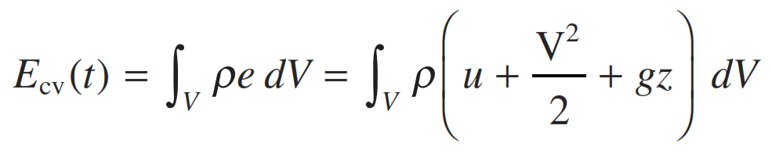
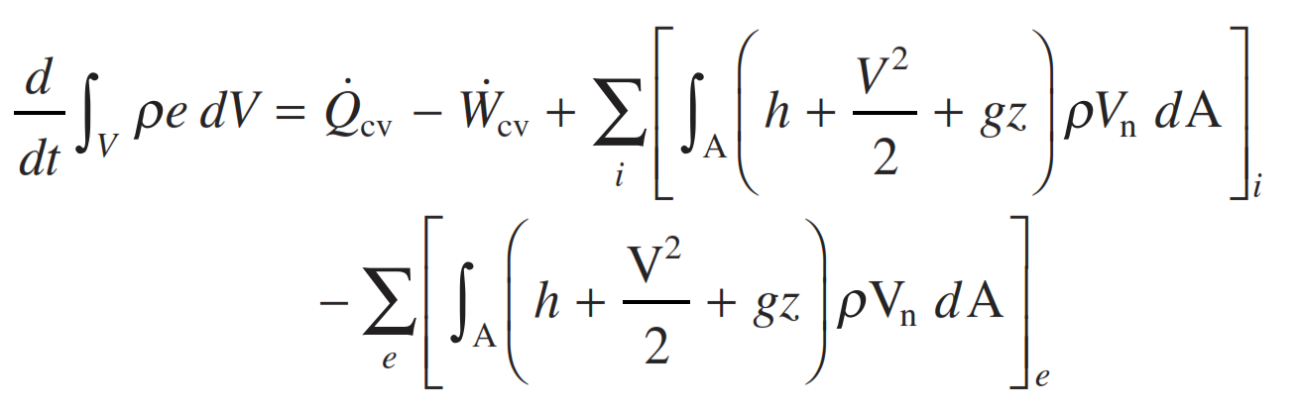
  The energy rate balance becomes

Slide 13
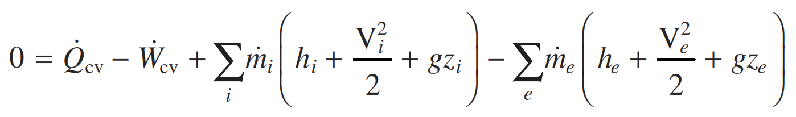
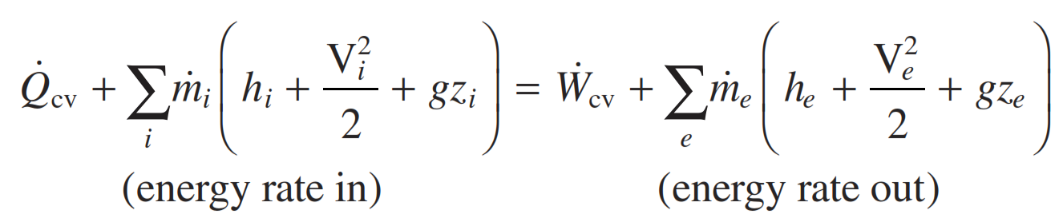
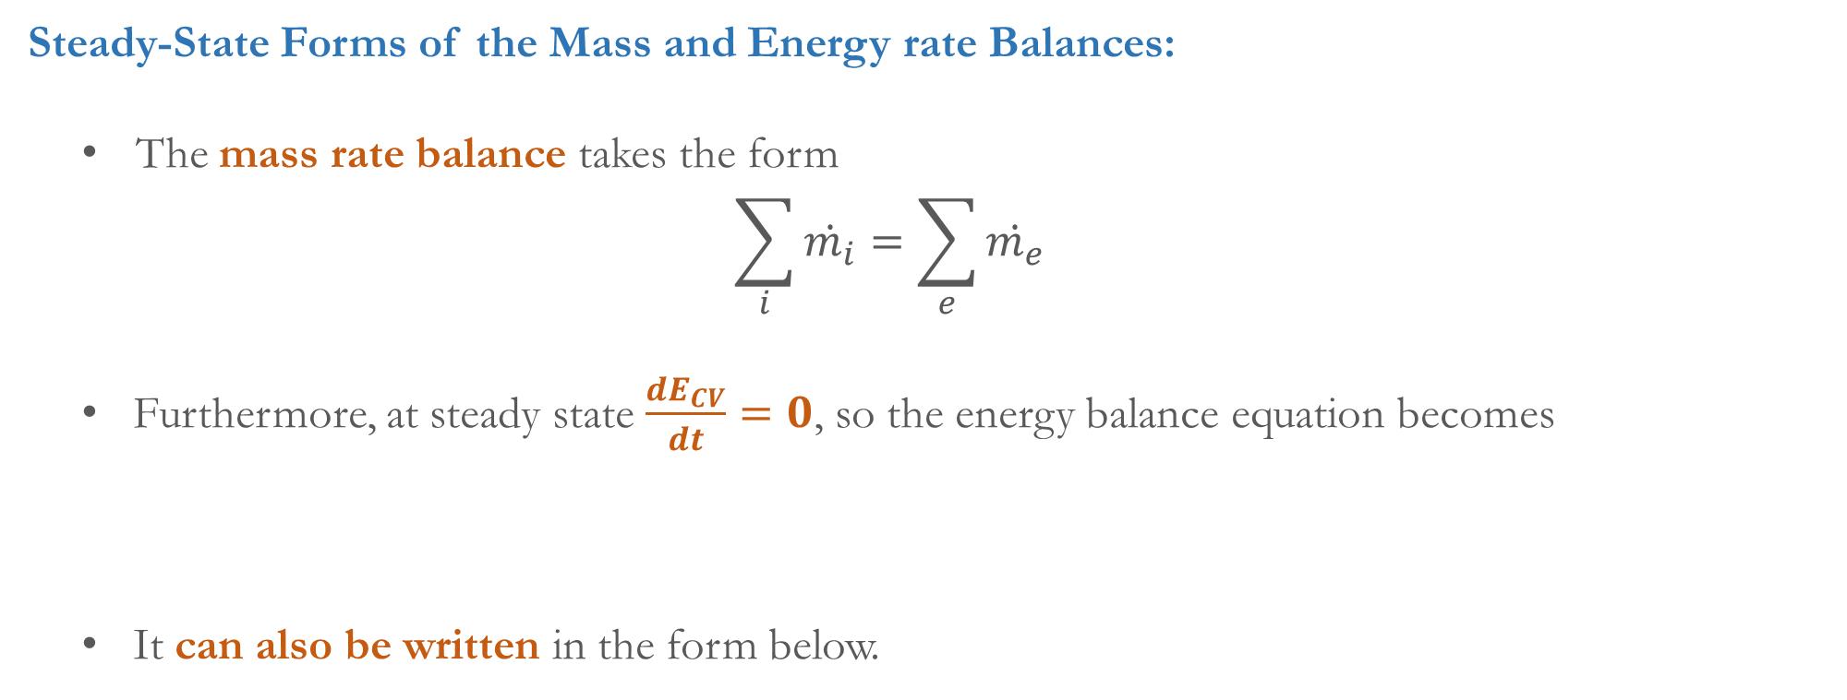
  Steady-State Forms of the Mass and Energy rate Balances:
  The mass rate balance takes the form
  $$\sum_{i}{\dot{m_{i}}}=\sum_{e}{\dot{m_{e}}}$$
  Furthermore, at steady state $\frac{dE_{CV}}{dt}=0$, so the energy balance equation becomes
  It can also be written in the form below.

Slide 14
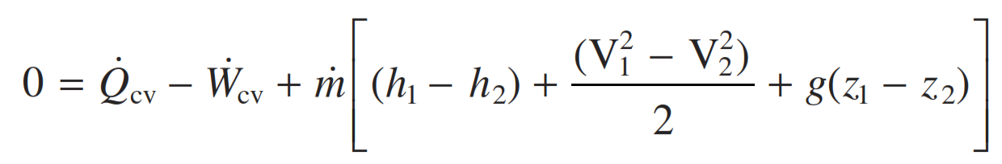
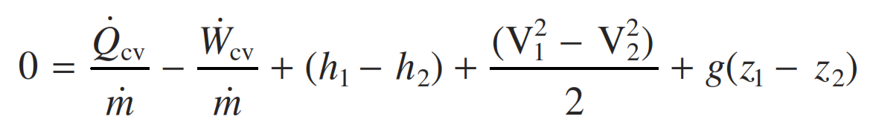
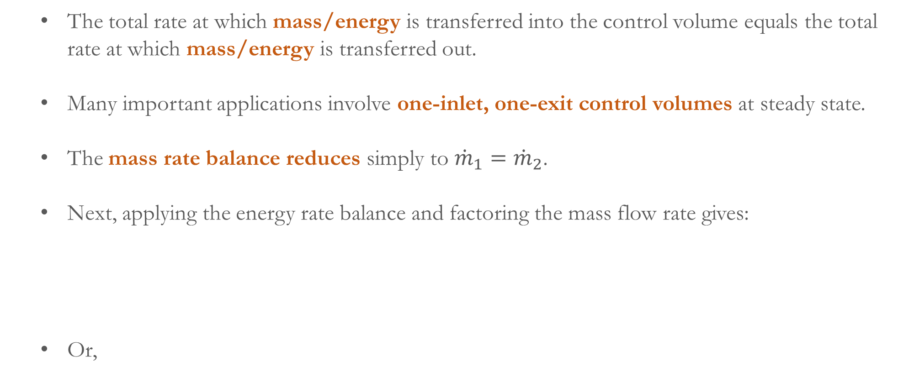
  The total rate at which mass/energy is transferred into the control volume equals the total rate at which mass/energy is transferred out.
  Many important applications involve one-inlet, one-exit control volumes at steady state.
  The mass rate balance reduces simply to ${\dot{m}}_{1}={\dot{m}}_{2}$.
  Next, applying the energy rate balance and factoring the mass flow rate gives:
  Or,

Slide 15
  The enthalpy, kinetic energy, and potential energy terms all appear as differences between their values at the inlet and exit.
  This steady-state forms of the energy rate balance relate only energy transfer quantities evaluated at the boundary of the control volume.
  When the mass and energy rate balances are applied to a control volume, simplifications are normally needed to make the analysis manageable.
  That is, the control volume of interest is modeled by making assumptions.
  Next, we present examples illustrating the analysis of several devices of interest in engineering,
  These include nozzles and diffusers, turbines, compressors and pumps, heat exchangers, and throttling devices.

Slide 16
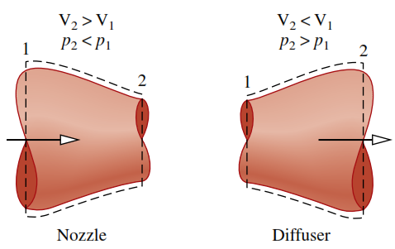
  Nozzles and Diffusers:
  A nozzle is a flow passage of varying cross-sectional area in which the velocity of a gas or liquid increases in the direction of flow.
  In a diffuser, the gas or liquid decelerates in the direction of flow.
  In a nozzle, the cross-sectional area decreases in the direction of flow and in a diffuser, the walls of the flow passage diverge (Figure).
  Nozzles and diffusers have several important engineering applications.
  A nozzle and diffuser are combined in a wind-tunnel test facility. Ducts with converging and diverging passages are commonly used in building air-conditioning systems.

Slide 17
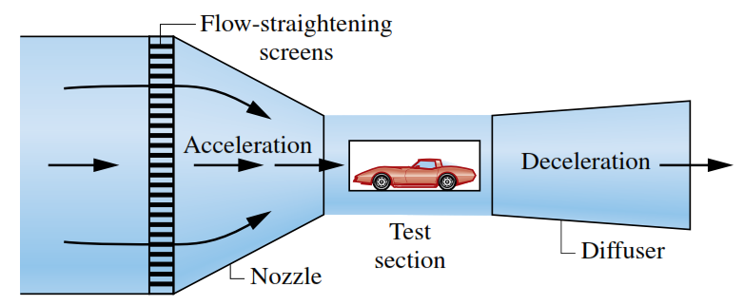
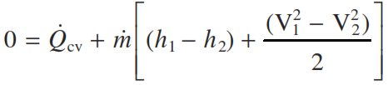
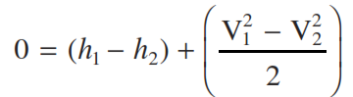
  Nozzles and diffusers also are key components of turbojet engines.
  Nozzles and diffusers also are key components of turbojet engines.
  For a control volume enclosing a nozzle or diffuser, the only work is flow work.
  The change in potential energy from inlet to exit is negligible under most conditions.
  Therefore,
  The heat transfer with the surroundings is often small enough relative to the enthalpy and kinetic energy terms that it also can be neglected.

